Slide 2
Cloud Computing Is it right for you?
John Craddock johncra@xtseminars.co.uk

Slide 3

John Craddock
Created by John Craddock, XTSeminars Ltd brings you world class IT seminars written and delivered by experts. As an infrastructure and security architect he has designed and implemented global distributed IT solutions, providing services to industry leaders including Microsoft.
John is an international speaker, delivering technical seminars, sessions and keynotes around the world and is a featured speaker at major IT conferences such as Microsoft TechEd.
John Craddock can be engaged as a consultant by contacting him directly:
Johncra@xtseminars.co.uk

Slide 4
What is Cloud Computing?

Slide 5
A Simple Definition
Making computing resources available as a utility service
Just like the National Electricity Grid
Electricity:
Available through a well defined interface
Available everywhere and for many devices
Power output, scales on demand
No need to know about how or where it’s generated
Reliable
Low capital expenditure for consumers
Pay for what you use

Slide 6
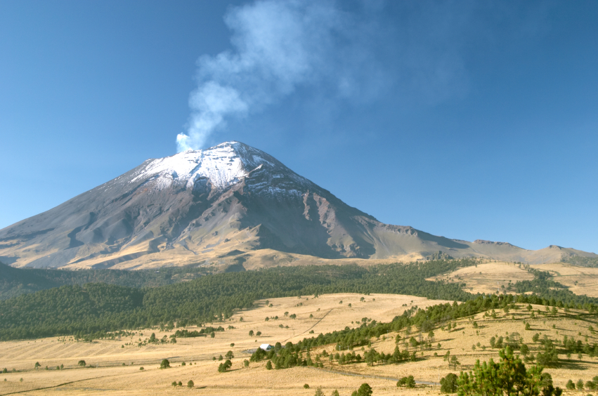
Not All Clouds Are Right for You

Slide 7
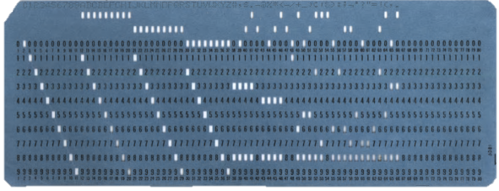
So What’s Changed?
Main frame
Bureau service
Compute on demand
Pay as you go
Low capital expenditure for consumers
Time….
The 60s
The future
+ Available everywhere
Well defined interface?
+ Available to many devices
+ Agility
I don’t know how it works, I just get the answers I need

Slide 8
On-Premise Computing
Requires hardware, space, electricity, cooling
Requires managing OS, applications and updates
Software Licensing
Difficult to scale
Too much or too little capacity
High upfront capital costs
You have complete control
and responsibility

Slide 9
Managing Demand
Forecast demand
IT Capacity
Potential business loss
Compute capacity
Over capacity
Under capacity
Wasted capacity
Entry barrier
Time

Slide 10
Demand Burst
Ouch! How do we deal with this?
IT Demand
Ticket sales open
Ticket sales open
Time
Concert ticket web site

Slide 11
IT Agility
How quickly can you
Scale up the infrastructure and applications?
Upgrade to the latest OS?
Respond to a company merger with new requirements for business process and IT capacity?
Respond to a divestiture

Slide 12
Cloud Computing
Shared, multi-tenant environment
Pools of computing resources
Resources can be requested as required
Available via the Internet
Private clouds can be available via private WAN
Pay as you go

Slide 13
Cloud Services
Software as a Service (SaaS)
Platform as a Service (PaaS) Infrastructure as a Service (IaaS)

Slide 14
The Stack
Application
Frameworks
OS Services
Operating System
Virtualized Instance
Hardware
High-speed network

Slide 15
Software as a Service (SaaS)
Application
Frameworks
OS Services
Google
Apps
Microsoft BPOS
Operating System
Virtualized Instance
Hardware
High-speed network

Slide 16
Platform as a Service (PaaS)
Your responsibility
Application
Your responsibility
Frameworks
OS Services
Google
AppEngine
Operating System
Windows Azure
Virtualized Instance
Hardware
High-speed network

Slide 17
Infrastructure as a Service (IaaS)
Application
Frameworks
Your responsibility
OS Services
Operating System
Virtualized Instance
Amazon EC2
VMware
Hardware
High-speed network

Slide 18
Many Players in the Game
To name a few
SaaS: Microsoft, Salesforce, Zimra, Oracle, Cisco, Google Apps
PaaS: Microsoft, Force.com, Spring Source, Google App Engine
IaaS: Amazon, IBM, VMware
Expect change, the cloud is just beginning…
In the future expect to see all large vendors riding the complete stack

Slide 19

Geo-Distributed Datacentres
Larger vendors have proven track records for running services for large numbers of customers
Hosted in their own datacentres

Slide 20
An example of SaaS
Let’s look at Microsoft BPOS

Slide 21
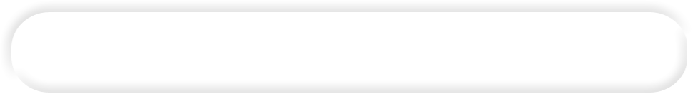






Microsoft Business Productivity Online Suite (BPOS)
Enterprise Email
Team Collaboration
Hosted and managed by Microsoft in Microsoft Data Centers.
Runs on PCs, smart phones and web browsers.
BPOS
Web Conferencing
Real-time Communications
Two service offerings BPOS Standard and BPOS dedicated

Slide 22
BPOS-D
Can be enabled or disabled / application
Internet
MSO Data Centre
BPOS-D managed network
Microsoft managed network
BPOS-D client network
Co-located domain controllers
WAN termination
WAN Cloud
Customer network

Slide 23
What We Get With SaaS
Lower capital expenditure
Fixed operational costs
Scalability
Reclaimed real estate
Innovation
Many vendors will have a forever green policy
Make sure it’s not forever beta
Lower carbon footprint
Reduced power and cooling
Agility
Customers get new services in months rather than years

Slide 24
What To Watch
You are relinquishing control and responsibility to the vendor by moving the service to the Cloud
For this to be a valid business proposition you must TRUST the vendor to deliver what they say they will
Financial penalties for failing to meet SLA are normally equated to service credits
May well be much less value than your business loss due to a failure
Many solutions appear attractive because of the bottom line pay/user price
Buyer beware!

Slide 25
Your Security Posture Changes
Data
Application
Host
Policies, Procedures and Governance
SaaS
provider
Physical Security
Identity
Machine Virtualisation
Abstracted Storage
PaaS
provider
Network
IaaS
provider
Perimeter

Slide 26
Does Their Security Match Your Requirements?
For 9X% of organizations, the Cloud providers probably offer better
Physical security
Policies, operational procedures and governance
And where supplied, OS and application updates
In most cases you will not be allowed to audit this
You will have to trust that they operate to the standards that they state
This may be backed by a yearly independent audit, ask to see it

Slide 27
Data Compliance is Paramount
How and where is it stored?
How is it backed up and restored?
Is data archived and what are the retention and disposal policies?
Do you have an on-premise policy?
Is access audited and can you view the logs?
What are the breach notification procedures?
Will they help you if litigation ensues
Does the provider match your legal and compliance requirements?

Slide 28
It’s Up to You
Just a few topics to get you thinking
There’s more…
Only you will know if a Cloud solution is going to meet the security requirements of your organization
Before you say NO
Remember, security is about the pragmatic balance between keeping the bad guys out and allowing your organisation to be agile and operational efficient

Slide 29
My Final Tip
Negotiate the contract and SLA from a position of strength
Know exactly what’s on offer
Don’t assume that because you can do something with an on-premise enterprise application it will be available via the Cloud
Read the small print
“Downtime Period” means, for a domain, a period of ten consecutive minutes of Downtime. Intermittent Downtime for a period of less than ten minutes will not be counted towards any Downtime Periods
Google SLA

Slide 30
An example of PaaS
Let’s look at Microsoft Azure

Slide 31

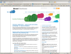

A Typical Application
Request
Database
Web layer
Business layer
Browser
Response
What do we do when it starts to overheat?
Request
Database
Web layer
Business layer
Response

Slide 32
Scale Out
NLB
Web layer
NLB
Business layer
Web layer
Business layer
Request
Database
Web layer
Business layer
Response
Web layer
Business layer
Web layer
Business layer
How much is that going to cost you?
Do you need it all the time?
How long will it take you?
Do you have the capital expenditure budget?

Slide 33
Azure
Web Role
Worker Role
Longer running processes
Web Role
Worker Role
Web Role
Worker Role
Request
Database
Web Role
Worker Role
Browser
Response
Communications via
Queues and Tables
Pay per role instance
Add and remove instances based on demand
Elastic computing!
Load balancing is part of the Azure fabric and automatically allocated

Slide 34
Compute Model
Worker Role
Worker Role
Database
Request
Web Role
Worker Role
Client
Response
Distribute task

Slide 35
Demand Burst With Azure
On-demand compute capacity
IT Demand
Compute Capacity
Ticket sales open
Ticket sales open
Time
Concert ticket website

Slide 36
Storage
On-Premise: Tight relationship between process and storage
Storage
Process
The Cloud abstracts the data
GET http://accountname.blob.core.windows.net/containername/blobname
Azure
Blob Storage
Client / Worker Role
Downloads a blob and associated metadata
Max blob size 64MB, metadata 8K / blob

Slide 37
Azure Storage
Azure
Table Storage
Client / Worker Role
Provides structured and semi-structured data storage capabilities
TDS
Worker Role
SQL Azure
TDS
Database synchronization
On-Premise application
On-Premise SQL

Slide 38
What We Get With PaaS
An elastic computing platform
Connect from anywhere, with any device
Low barrier costs to deploying new applications
Rapid provisioning
Pay as you go
Operational costs directly related to profit
A marketplace through which to sell our services
Customers continue to pay as long as they use our services
Stop paying, stop providing service
No chance of licence abuse

Slide 39
What To Watch
Check your security policies can be satisfied by the Cloud provider
Does the SLA meet availability requirements?
Don’t just port an existing app that have been sitting within your security perimeter
Make sure it has been engineered for Internet security
Follow Security Development Lifecycle (SDL) best practices

Slide 40

IaaS
Staged or direct migration
Virtualized Instance
P2V
Hardware
V2V
Public Cloud
P2V
P2V
Virtualized Instance
Virtualized Instance
V2V
Hardware
Hardware
Private Cloud
On-premise

Slide 41
What to Watch?
Check your security policies can be satisfied by the Cloud provider
Does the SLA meet availability requirements?
You are now porting your OS and upper stack
You will need to maintain it
Remember the Cloud is its infancy
It’s immature
We all have lots to learn

Slide 42



So everything is in the Cloud What do we do?
Innovate

Slide 43
Reframe Your Thinking
Use the best of breed
CRM
Ordering
invoicing
CRM
Ordering
Invoicing
Stop thinking about applications running on servers
Think of them as pay on demand services
Communications
Business forecasting
Rapidly add and try new functionality
Social Networking

Slide 44
New Business Opportunities
?
Test out new ideas with small upfront costs
Can you sell in-house expertise by packaging as a service?
If you need to scale rapidly, you can
More operational cost = More profit

Slide 45
Federate Identity
We need to have an Identity that will be trusted everywhere
Come to my session at 1:30 today on Active Directory Federation Services

Slide 46

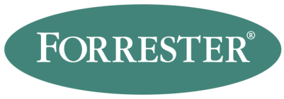
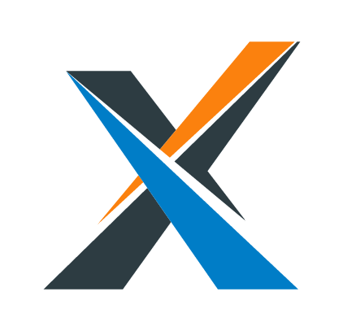
Should We Move To The Cloud?
Can we afford not to?
“By 2012, 80% of Fortune 1000 enterprises will be using some cloud computing services, 20% of businesses will own no IT assets.”
“The bottom line: Early adopters are finding serious benefits, meaning that cloud computing is real and warrants your scrutiny as a new set of platforms for business applications.”

Slide 47
So What is Cloud Computing?
It’s a utility
Providing us with
New ways of working
A chance to innovate
A new market place

Slide 48
I’m in
Are you?

Slide 49
Enjoy the rest of the day

